Slide 1
LEADING

Slide 2
Creativity
What is Creativity?
  It is the reorganization of experience into new configurations.
  A function of knowledge, imagination, and evaluation
Three domains of creativity
  Art (ah!) as in beauty
  Discovery (aha!) as in enlightenment.
  Humor (haha!) as in joyful pleasure.

Slide 3
Creativity At Work
The generation and the IMPLEMENTATION of ideas
Aims to benefit the organisation
Complex reiterative process

Slide 4
Learning to Be More Creative:
Mental Locks That Block Creativity
Looking for the “right” answer.
Always trying to be logical.
Strictly following the rules.
Insist on being practical.
Becoming too specialized.
Not wanting to look foolish.
Saying “I’m not creative.
Avoiding ambiguity.

Slide 5
Enhancing creativity
Four factor model:
    Creative Orientation
    Ideas Guidance
    Social Support
    Empowerment
Brainstorming
Synectics

Slide 6
INNOVATION AND ENTREPRENEUR
finding better ways of doing things;
includes improving techniques & methods
* Responds to possibility of change as well as speeds up the change itself
* Is a accumulation of small insights
* Involves investing in development of skills as well as physical and marketing assets/ tools.
* Improves competitiveness of enterprise

Slide 7
INNOVATION TYPES
- Development of new products for existing markets
- Development of new markets for existing products
- Development of new products for new markets
- Development of existing products for existing markets

Slide 8
MOTIVATION

Slide 9
The Nature of People
Individual Differences
Importance of Personal Dignity
Considering a whole person
Multiplicity of roles

Slide 10
Behavioral Models
Rational Economic
Social Assumption
Self-actualization
Complex assumption

Slide 11
Motivation is
the set of forces that lead people to behave in particular ways

Slide 12
The Motivation Process
Unsatisfied
Need
Tension
Drives
Search
Behavior
Satisfied
Need
Reduction
of Tension

Slide 13
Classification Of Motivation Theories
Content Theories
  Need Hierarchy Theory
  Two-Factor Theory
  Mc Gregor theory
  Need Theory
  ERG
Process Theories
  Expectancy Theory
  Equity Theory

Slide 14
Maslow’s Hierarchy of Needs

Slide 15
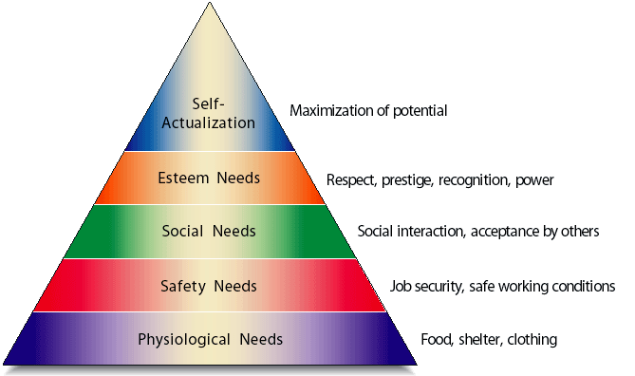
Maslow’s Hierarchy of Needs
Exhibit 10.2

Slide 16
Maslow’s Hierarchy of Needs
Maslow believed people rank their needs into five categories
  Physiological: basic requirements for survival
  Safety: job security and safe working conditions
  Social: need to be part of a group
  Esteem: respect, prestige, recognition
  Self-actualization: need to fully reach one’s potential
Once people achieve a given category of needs, they become motivated to reach the next category.

Slide 17
TWO FACTOR Theory

Slide 18
Herzberg’s Motivation-Hygiene
Motivators Hygiene Factors
Achievement
Recognition
Work itself
Responsibility
Advancement
Growth
Supervision
Company policy
Relationship with
supervisor
Working conditions
Salary
Relationship with peers
Relationship with
subordinates
Security
Extremely satisfied Neutral Extremely dissatisfied

Slide 19
Contrasting Views of Satisfaction-Dissatisfaction
Traditional View
Satisfaction Dissatisfaction
Herzberg’s View
Motivators
Hygiene Factors
Satisfaction No Satisfaction
No Dissatisfaction Dissatisfaction

Slide 20
Mc Gregor theory of X and Y

Slide 21
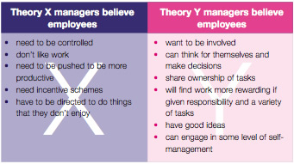

Slide 22
NEED Theory

Slide 23
The Three
Needs Theory
(McClelland)
Achievement
(nAch)
Affiliation
(nAff)
Power
(nPow)

Slide 24
What Motivates You?
I try very hard to improve on my past performance at work.
I enjoy competition and winning.
I often find myself talking to those around me about nonwork matters
I enjoy a diffficult challenge
I enjoy being in charge
I want to be liked by others
I want to know how I am progressing as I complete tasks
I confront people who do things I disagree with
I tend to build close relationships with co-workers
I enjoy setting and achieving realistic goals
I enjoy influencing other people to get my way
I enjoy belonging to groups and organizations
I enoy the satisfaction of completing a difficult task
I often work to gain more control over the events around me
I enjoy working with others more than working alone

Slide 25
What Motivates Me? Results
1, 4, 7, 10, 13 – Achievement
2, 5, 8, 11, 14 – Power
3, 6, 9, 12, 15 - Affiliation

Slide 26
ERG Theory

Slide 27
ERG Theory
(Alderfer’s)
Existence
Growth
Relatedness

Slide 28
Expectancy Theory

Slide 29
Expectancy Theory
An individual’s assessment of the cost/benefit ratio of completing a particular task based on their perception of the value and likelihood of a reward and the effort necessary to complete that task

Slide 30
(Vroom’s) Expectancy Theory
Employee’s efforts are most influenced by the expected outcome (reward) for those efforts:
  When goals are achievable and offer desirable rewards.
  Employees have a strong belief that they have a chance to earn the reward.
Motivating rewards are difficult to offer when output cannot be measured easily.

Slide 31
Expectancy Theory
Value of reward
Expectancy
Desire to Perform
Effort
Instrumentality

Slide 32
Equity Theory

Slide 33
Equity Theory
Compensation should be equitable, or in proportion to each employee’s contribution
  If employees believe that they are under compensated, they may request greater compensation–a raise.
  If their compensation is not increased, employees may reduce their contribution
  Employees become dissatisfied with their jobs if they feel that they are not equitably compensated.

Slide 34
Equity Theory
Perceived
Ratio Comparison
Employee’s
Assessment
Outcomes A
Inputs A
Outcomes A
Inputs A
Outcomes A
Inputs A
<
Outcomes B
Inputs B
Outcomes B
Inputs B
Outcomes B
Inputs B
Inequity (Under-Rewarded)
=
Equity
>
Inequity (Over-Rewarded)
ªPerson A is the employee, and person B is a relevant other or referent.

Slide 35
Enhancing Motivation

Slide 36
Suggestions for
Motivating Employees
Recognize individuals
Match people to jobs
Use goals
Make goals attainable

Slide 37
Suggestions for
Motivating Employees
Individualize rewards
Link rewards to performance
Check the system for equity
Don’t ignore money

Slide 38
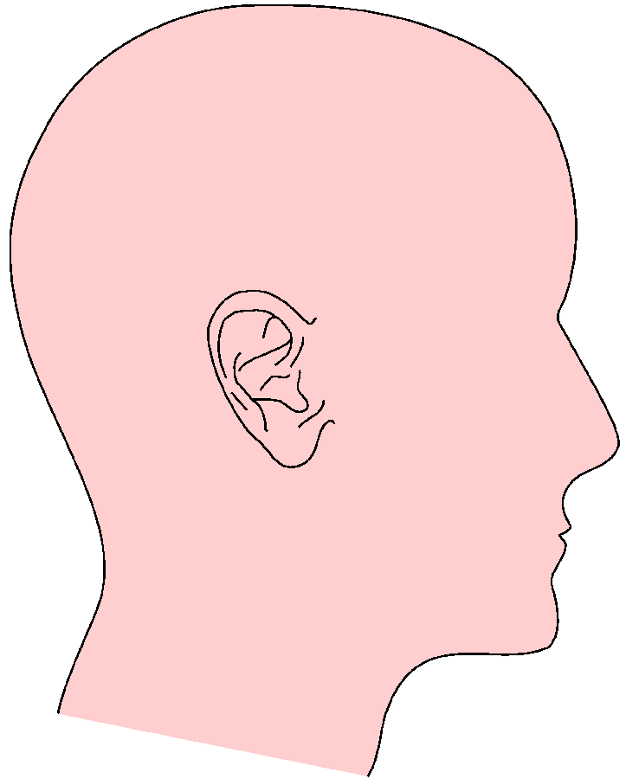
Intrinsic vs. Extrinsic Rewards
Extrinsic = Outside
Recognition
Intrinsic = Inside
Praise
Feeling of Job Well Done
Pride
Promotions
Salary Increase
Sense of Achievement
Status
Gifts

Slide 39
Enhancing Motivation
Job enrichment programs
  Designed to increase the job satisfaction of employees by increase their autonomy.
Flexible work schedule (flextime)
  Compressed work weeks that compress the work load into fewer days per week.
  Job sharing by two or more persons who share a particular work schedules.

Slide 40
Employee Involvement Programs
Job enlargement
  A program to expand (enlarge) the jobs assigned to employees
Job enrichment
  Increasing the variety of job tasks and the autonomy of employees
Job rotation
  Allowing employees to periodically rotate (switch) their job assignment

Slide 41
LEADERSHIP

Slide 42
Leadership
- The ability to positively influence people and systems to have a meaningful impact and achieve results
- Is a process whereby a person inspires a group of constituents to work together using appropriate means to achieve common mission and common goals.

Slide 43
Core Leadership Skills
Vision
Empowerment
Intuition
Self-understanding
Strong Value System

Slide 44
Leadership Theories
Trait approach
Behavioral approach
Contingency (situational) approach

Slide 45
Trait Theories

Slide 46
Trait Theories
  Assume that traits play a key role in:
    Differentiating between leaders and nonleaders.
    Predicting leader or organizational outcomes.
  Great-person-trait approach.
    Earliest approach in studying leadership.
    Tried to determine the traits that characterized great leaders.

Slide 47
Identifiable characteristics of leaders
  Energetic.
  Ambitious.
  Oriented toward self-improvement.
  Integrity.
  Not easily discouraged.
  Deals well with large amounts of information.
  Above-average intelligence.
  Possess specific knowledge concerning their industry, firm, and job.

Slide 48
BEHAVIORAL THEORIES

Slide 49
Behavioral theories
  Assume that leader behaviors are crucial for explaining performance and other organizational outcomes.
  Major behavioral theories.
    Iowa , Ohio & Michigan leadership studies.
    Leadership Grid.

Slide 50
MICHIGAN LEADERSHIP STUDIES
  Iowa studies
  (Autocratic, democratic & laissez-faire)
  Michigan studies
  Employee-centered supervisors.
    Place strong emphasis on subordinate’s welfare.
  Production-centered supervisors.
    Place strong emphasis on getting the work done.

Slide 51
OHIO STATE LEADERSHIP STUDIES
  Consideration.
    Concerned with people’s feelings and making things pleasant for the followers.
  Initiating structure.
    Concerned with defining task requirements and other aspects of the work agenda.
  Effective leaders should be high on both consideration and initiating structure.

Slide 52
LIKERT FOUR SYSTEMS OF MANAGEMENT
“EXPLOITIVE – AUTHORITATIVE”
“BENEVOLENT – AUTHORITATIVE”
“CONSULTATIVE – AUTHORITATIVE”
“PARTICIPATIVE – AUTHORITATIVE”

Slide 53
LEADERSHIP GRID
Five key Grid combinations.
  1/1 — low concern for production, low concern for people. (Improvised Mgt)
  1/9 — low concern for production, high concern for people. (Country Club Mgt)
  5/5 — moderate concern for production, moderate concern for people. (Middle of the road mgt)
  9/1 — high concern for production, low concern for people. (Authority Compliance)
  9/9 — high concern for production, high concern for people. (Team Mgt)

Slide 54
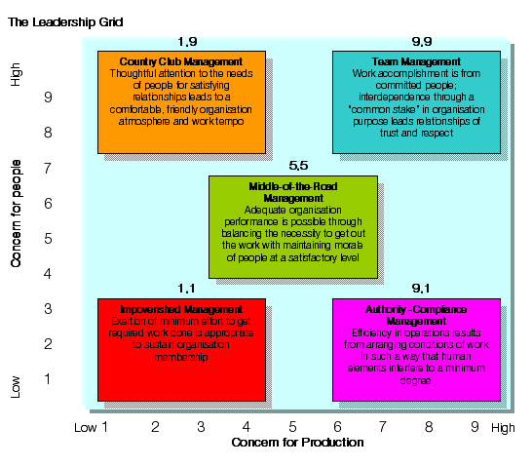
LEADERSHIP GRID
  Developed by Robert Blake and Jane Mouton.
  Built on dual emphasis of consideration and initiating structure.
  A 9 x 9 Grid (matrix) reflecting levels of concern for people and concern for task.
    1 reflects minimum concern.
    9 reflects maximum concern.

Slide 55
Leader-Member Exchange (LMX) theory
  Focuses on the quality of the working relationship between leaders and followers.
  LMX dimensions determine followers’ membership in leader’s “in group” or “out group.”
  Different relationships with “in group” and “out group.”

Slide 56
CONTINGENCY (SITUATIONAL) APPROACH

Slide 57
Contingency (situational) approach
Leader traits and behaviors can act in conjunction with situational contingencies.
The effects of leader traits are enhanced by their relevance to situational contingencies.
Major situational contingency theories.
  Fiedler’s leadership contingency theory.
  House’s path-goal theory of leadership.
  Hersey and Blanchard’s situational leadership model.

Slide 58
FIEDLER’S LEADERSHIP CONTINGENCY THEORY.

Slide 59
Fiedler’s leadership contingency theory.
  Initiated the situational contingency approach in the mid-1960s.
  Fiedler’s approach emphasized that group effectiveness depends on an appropriate match between the leader’s style and situational demands.

Slide 60
Key variables in Fiedler’s contingency model
Situational control is a function of:
    Leader-member relations.
    Task structure.
    Position power.
  Least preferred co-worker (LPC) score reflects a person’s leadership style.
  LPC (Favorable) leaders have a relationship-motivated style.
  Low (Un Favorable) LPC leaders have a task-motivated style.

Slide 61
HOUSE’S PATH-GOAL THEORY OF LEADERSHIP

Slide 62
House’s path-goal theory of leadership
  Emphasizes how a leader influences subordinates’ perceptions of both work goals and personal goals and the links, or paths, found between these two sets of goals.
  The theory assumes that a leader’s key function is to adjust his/her behavior to complement situational contingencies.

Slide 63
House’s path-goal theory of leadership
  Leader behaviors.
    (Instrumental) Directive leadership.
    Supportive leadership.
    Achievement-oriented leadership.
    Participative leadership.
  Situational contingency variables.
    Subordinate attributes — Needs, confidence and ability.
    Work setting attributes — task, formal authority system, and primary work group.

Slide 64
Hersey And Blanchard’s Situational Leadership Model

Slide 65
Hersey and Blanchard’s situational leadership model
  Emphasizes the situational contingency of maturity, or “readiness,” of followers.
  Readiness is the extent to which people have the ability and willingness to accomplish a specific task.
  Leader style and follower readiness.
    A telling style is best for low readiness.
    A selling style is best for low to moderate readiness.
    A participating style is best for moderate to high readiness.
    A delegating style is best for high readiness.

Slide 66
Transactional Vs Transformational Leaders

Slide 67
Characteristics of Transactional Leaders
Contingent Reward
  Contracts exchange of rewards for effort, promises rewards for good performance, recognizes accomplishments.
Management by Exception (active)
  Watches and searches for deviations from rules and standards, takes corrective action.
Management by Exception (passive):
  Intervenes only if standards are not met.

Slide 68
Characteristics of Transformational Leaders
Charisma
  Provides vision and sense of mission, instills pride, gains respect and trust.
Inspiration
  Communicates high expectations, uses symbols to focus efforts, expresses important purposes in simple ways.
Intellectual Stimulation
  Promotes intelligence, rationality, and careful problem-solving.
Individualized Consideration
  Gives personal attention, treats each employee individually, coaches, advises.

Slide 69
.
If you will, imagine yourself walking through the front door of a glass office building on the corner of a bustling downtown city block

Slide 70
People are swinging leather bags full of documents and wearing Armani suits and Ferragamo shoes as they walk past flower stands selling loose roses and fresh-cut sunflowers. As you push the heavy darkened door, you see a reception desk across the wide marble floor. Inset in the marble is a replica of a compasss surrounding the logo of the organization, and above it a set of clocks reports the time in different parts of the world. A woman wearing a suit, matching lipstick and a cordless headset directs calls over a vast switchboard that becomes visible as you approach the uniformed security agent who gives you directions. When the brass-trimmed elevator door opens, you find yourself in a glassed entry that allows a sweeping view of a long conference table and the city 30 stories below.
Humor us with another imaginary voyage. It’s been a long day at work and you realize there’s nothing in the house for dinner. You decide to go out for some quick food. You cross a wide parking lot leading into a small entryway with automatic doors that open into a waiting area where other people are standing. Resting your hand on the metal posts that direct you into your place in line, you look up to see a menu that is posted on the wall along with pictures of food. Looking around, you see the sticky linoleum floor and a colorful play area. When you finally get to the front of the line, the young person looking at the cash register cannot seem to get your order correct. She calls a manager, who appears holding a heavy bundle of keys to correct the mistake.
So, where have we been?

Slide 71
MANAGING COMMUNICATION

Slide 72

COMMUNICATION DEFINED
Communication Defined
A process in which one person or group evokes a shared or common meaning to another person or group

Slide 73
Communication
Communication
Oral
  All forms of spoken information and is by far the preferred type of communication used by managers.
Written
  Includes letters, memos, policy manuals, reports, and other documents used to share information used in an organization.
Nonverbal
  Involves all messages that are nonlanguage responses.

Slide 74
The Communication Process
The Communication Process
Basic Elements in the Communication Process
Social context
Sender
Encodes
Medium
Decodes
Receiver
Feedback
Noise
Noise

Slide 75
Basic Elements in the Communication Process
Basic Elements in the Communication Proces4
Element 1 Social Context
  The setting in which a communication takes place.
Element 2 Sender and Message Encoding
  Encoding -
    Translating the sender’s ideas into a systematic set of symbols or a language expressing the communicator’s purpose.

Slide 76
Basic Elements in the Communication Process
Basic Elements in the Communication Proces4
Element 3 Message and Medium
  Messages
    The tangible forms of coded symbols that are intended to give a particular meaning to the data.
  Medium
    The carrier of the message or the means by which the message is sent.

Slide 77
Basic Elements in the Communication Process
Element 3 Receiver and Message Decoding
  Decoding
    The translation of received messages into interpreted meanings.
Element 4 Feedback
  The process of verifying messages and the receiver’s attempts to ensure that the message decoded is what the sender meant to convey.
Element 5 Noise
  Any internal or external interference or distraction with the intended message that can cause distortion in the sending and receiving of messages.

Slide 78
Managing Communication Within Diverse Organizations
Organizational Communication Flows
Upward
Downward
Horizontal
Information
Instructions Directives
Coordination

Slide 79
Vertical Communication
Vertical Communication
Downward Communications
  Flows from individual in higher levels of the organization to those in lower levels.
  Includes meetings, offical memos, policy statements, manuals, and company publications.
Upward Communications
  Consists of messages sent up the line from subordinates to bosses.
  Includes (1) personal reports of performance, problems or concerns, (2) reactions to organizational policies, and (3) employee suggestions

Slide 80

Lateral Communication
The horizontal information flow that occurs both within and between departments
The purpose of lateral communications is coordination

Slide 81

Barriers to Effective Communications
Barriers to Effective Communications
Cross-Cultural Diversity
  The greater the difference between the sender’s and receiver’s cultures, the greater the chance for miscommunication.
Trust and Honesty
  A lack of trust can cause the receiver to look for hidden meanings in the sender’s message.

Slide 82
Barriers to Effective Communications
Barriers to Effective Communications
Information Overload
  The increasing use of technology in organizations is often leading to overload when the amount of information we can process is exceeded.
Gender Differences
  Because males and females are often treated differently from childhood, they tend to develop different perspectives, attitudes about life, and communication styles.

Slide 83
Barriers to Effective Communications
Perception
  Two people may perceive the same thing in different ways and miscommunication happen.
Language Characteristics
  When two individuals are using different meanings or interpretations of the same word and do not realize it, a communication barrier exists.
Other Factors
  Time pressures may cause us to focus on information that helps us make decisions quickly, although the information may not be of high quality.
  Feedback may be impaired or absent.

Slide 84
Nonverbal Communication Skills
Nonverbal communication skills are essential for sending and decoding messages with emotional content.
Dimensions of nonverbal communication:
  Body movements and gestures
  Eye contact
  Touch
  Facial expressions
  Physical distance
  Tone of voice

